Slide 1
Using College Programs of Study to Help Choose High School Courses

Slide 2
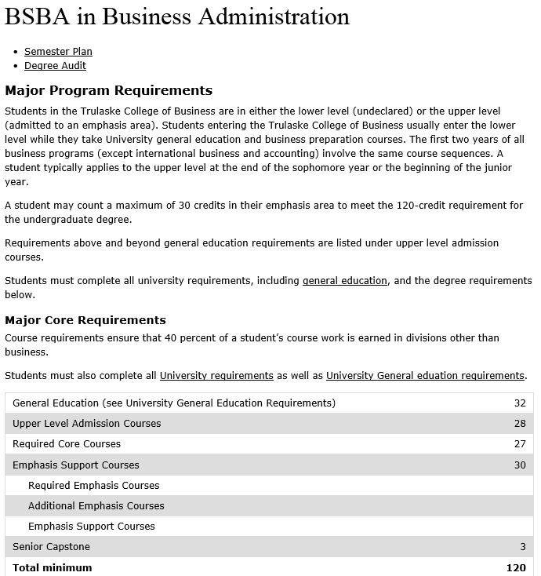
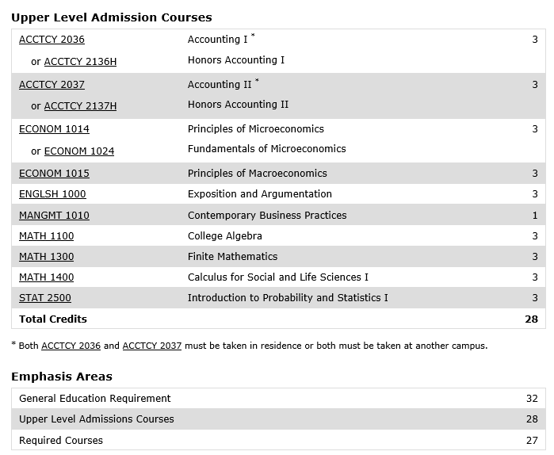
What is a Program of Study?
A Program of Study is an outline of what courses you will need to complete in order to graduate with a specific major in college.

Slide 3
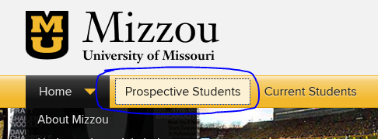
How do I find a program of study for my intended major?
Most colleges post programs of study under the “academics” or “majors” section of their website.
Ex. To access MU’s programs of study go to the mu homepage (www.Missouri.edu) → “prospective students” →choose “majors” from the “academics” drop down menu

Slide 4
Why would I need to Use a College Program of Study now?
You can use a Program of Study to help guide your high school courses by looking ahead at what you will need to take in college and choosing to take classes here at Rock Bridge that will best prepare you for that coursework.
View this Video on How to Access Programs of Study and how you can use the information from the program of study to guide you as you choose your rock bridge classes for next year.
http://screencast.com/t/jFNwFc9pT

